Slide 1
Diagonalization Strategies in Ab Initio Quantum Chemistry
Zachary Windom
Department of Chemistry
Quantum Theory Project
University of Florida
12/07/2020

Slide 2
Table of Contents:
Background of Electronic Structure Theory
Lanczos Diagonalization for Hermitian Matrices
Davidson’s Diagonalization for Hermitian Matrices

Slide 3
Ab initio Quantum Chemistry 101
GOAL: Obtain molecular/material properties from first principles
Full Configuration Interaction (FCI) - yields the exact answer in the basis set limit; not true when truncated. Scales as ~O(2^n)
Coupled Cluster Theory (CC) – strategic way of rapidly converging to FCI results. Scales as ~O(n^6)
CIS
CID
CIT
CIQ
Virtual
c
b
a
Occupied
j
i
D. Antara and C. D. Sherrill. JCP 118.4 (2003): 1610-1619

Slide 4
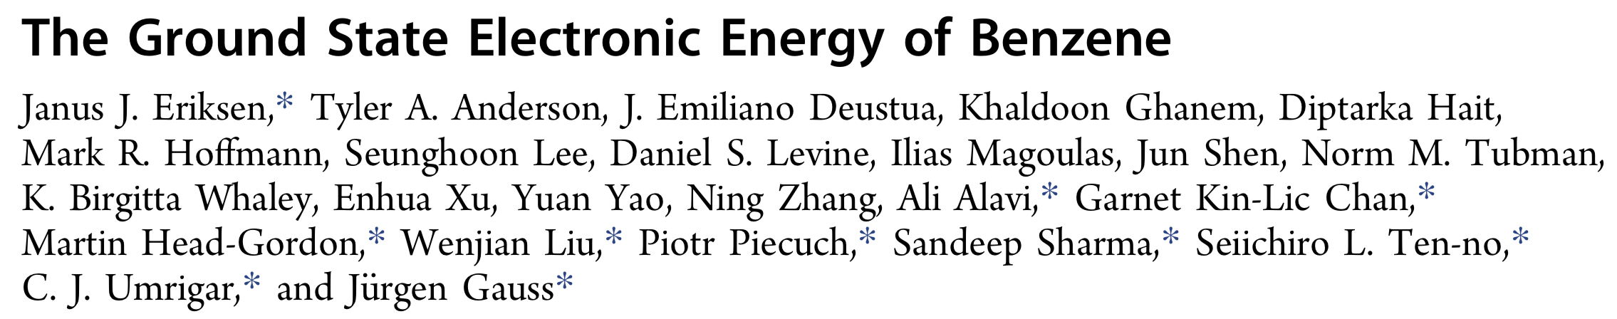
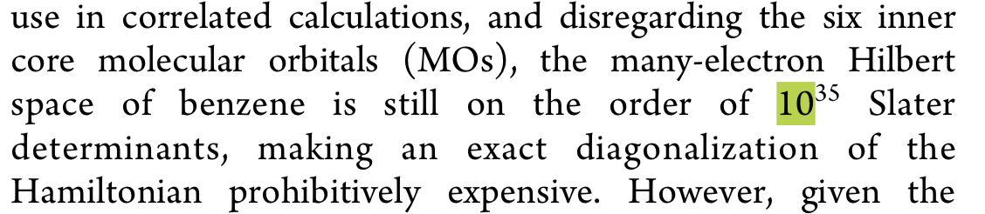
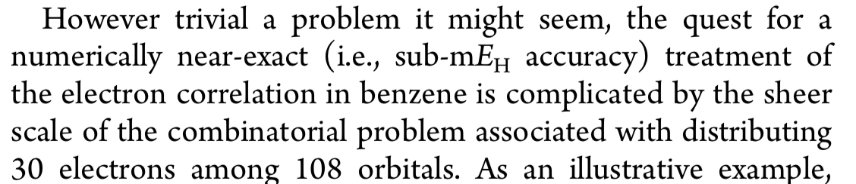
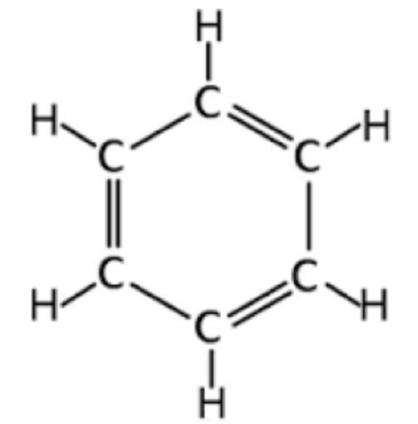
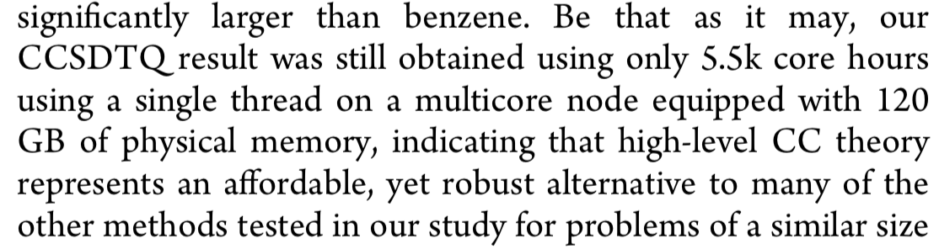

Slide 5

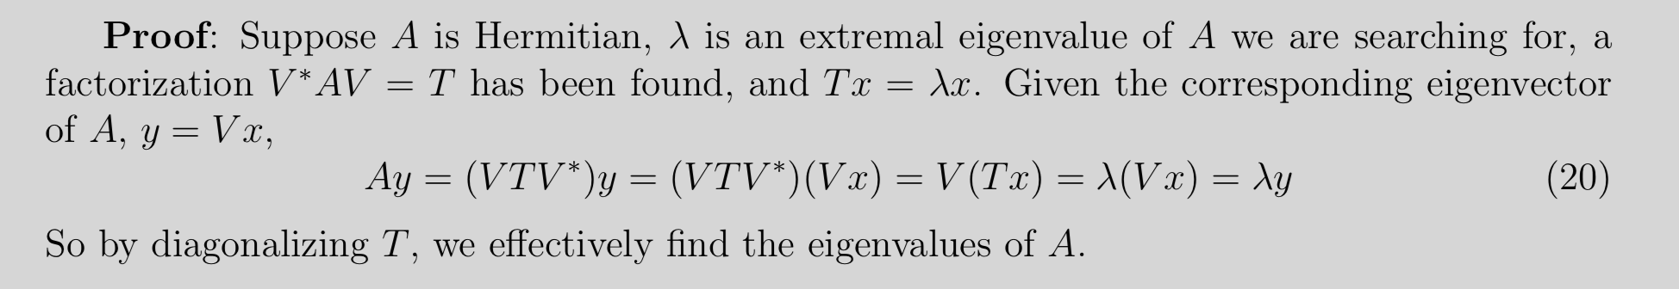
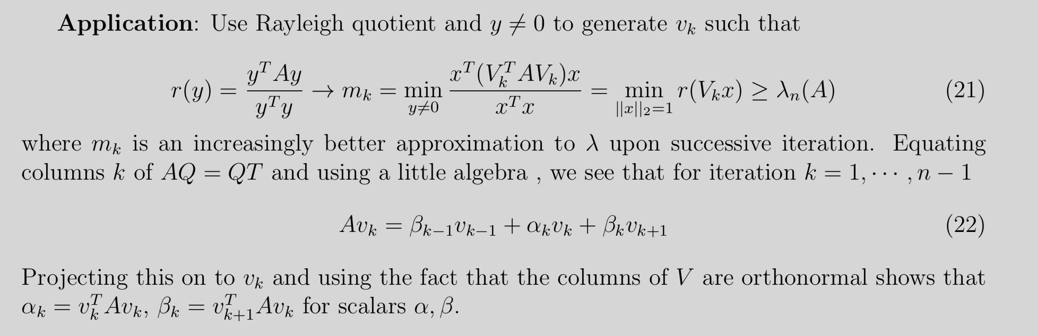
Background: Lanczos Diagonalization For CI

Slide 6
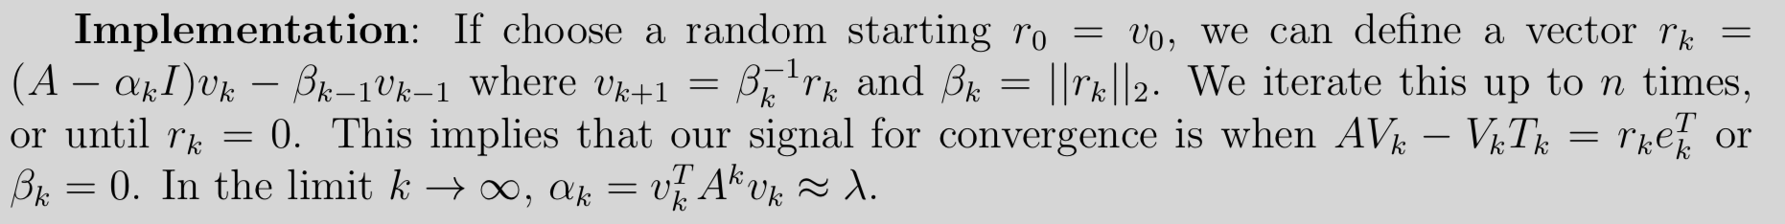
Background: Lanczos Diagonalization For CI
For iteration k < m < Dimension of A:
Tk
rk
Ak
Vk
=
Vk
+
https://core.ac.uk/download/pdf/35469431.pdf

Slide 7
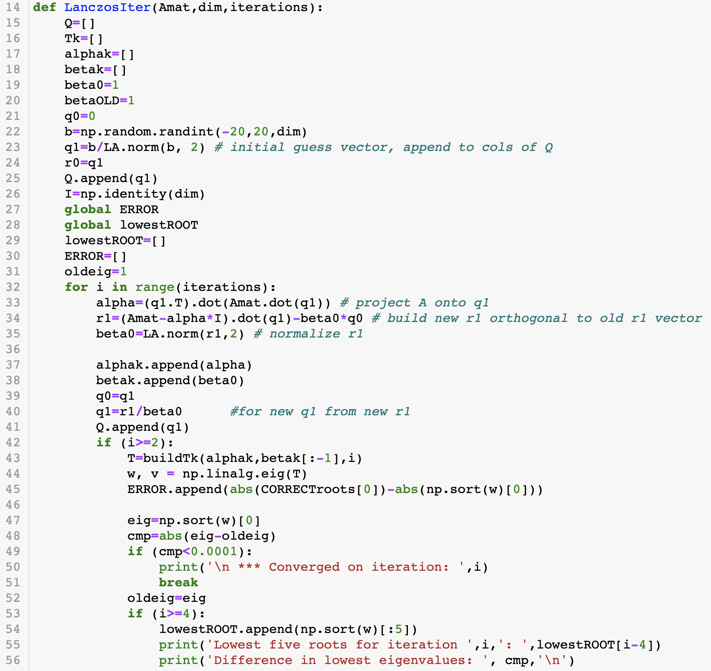
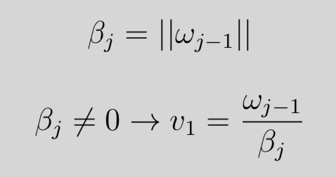
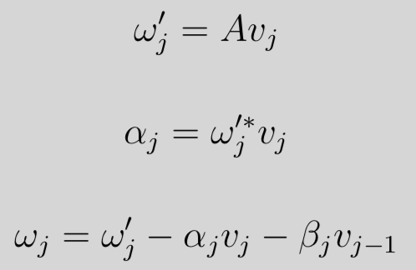
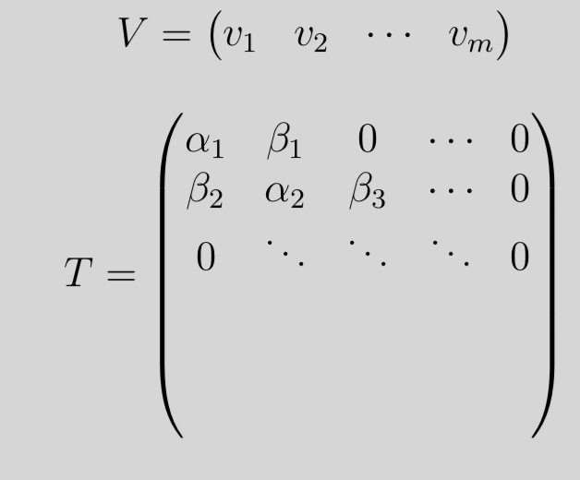
Lanczos’ Diagonalization Algorithm
Guess a normalized vector v1, and initialize
Do j=1,m
Set
IF
Else; END LOOP
Set
Store v1 in columns of V and alpha/beta into T
Diagonalize T
Converged?

Slide 8
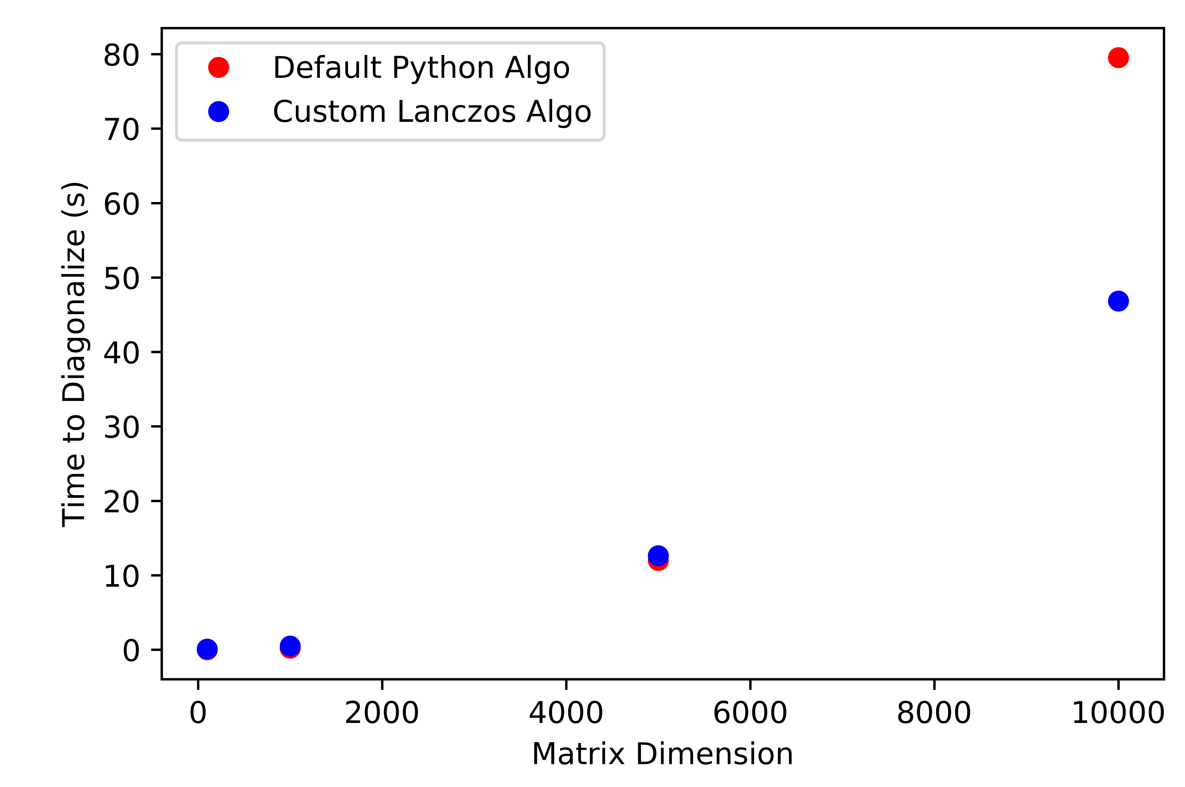
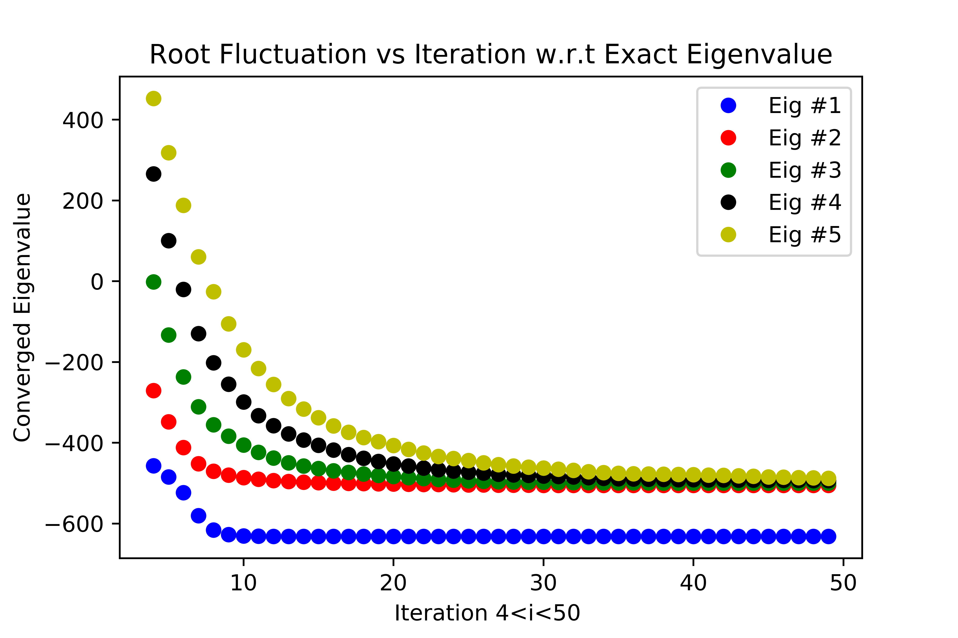
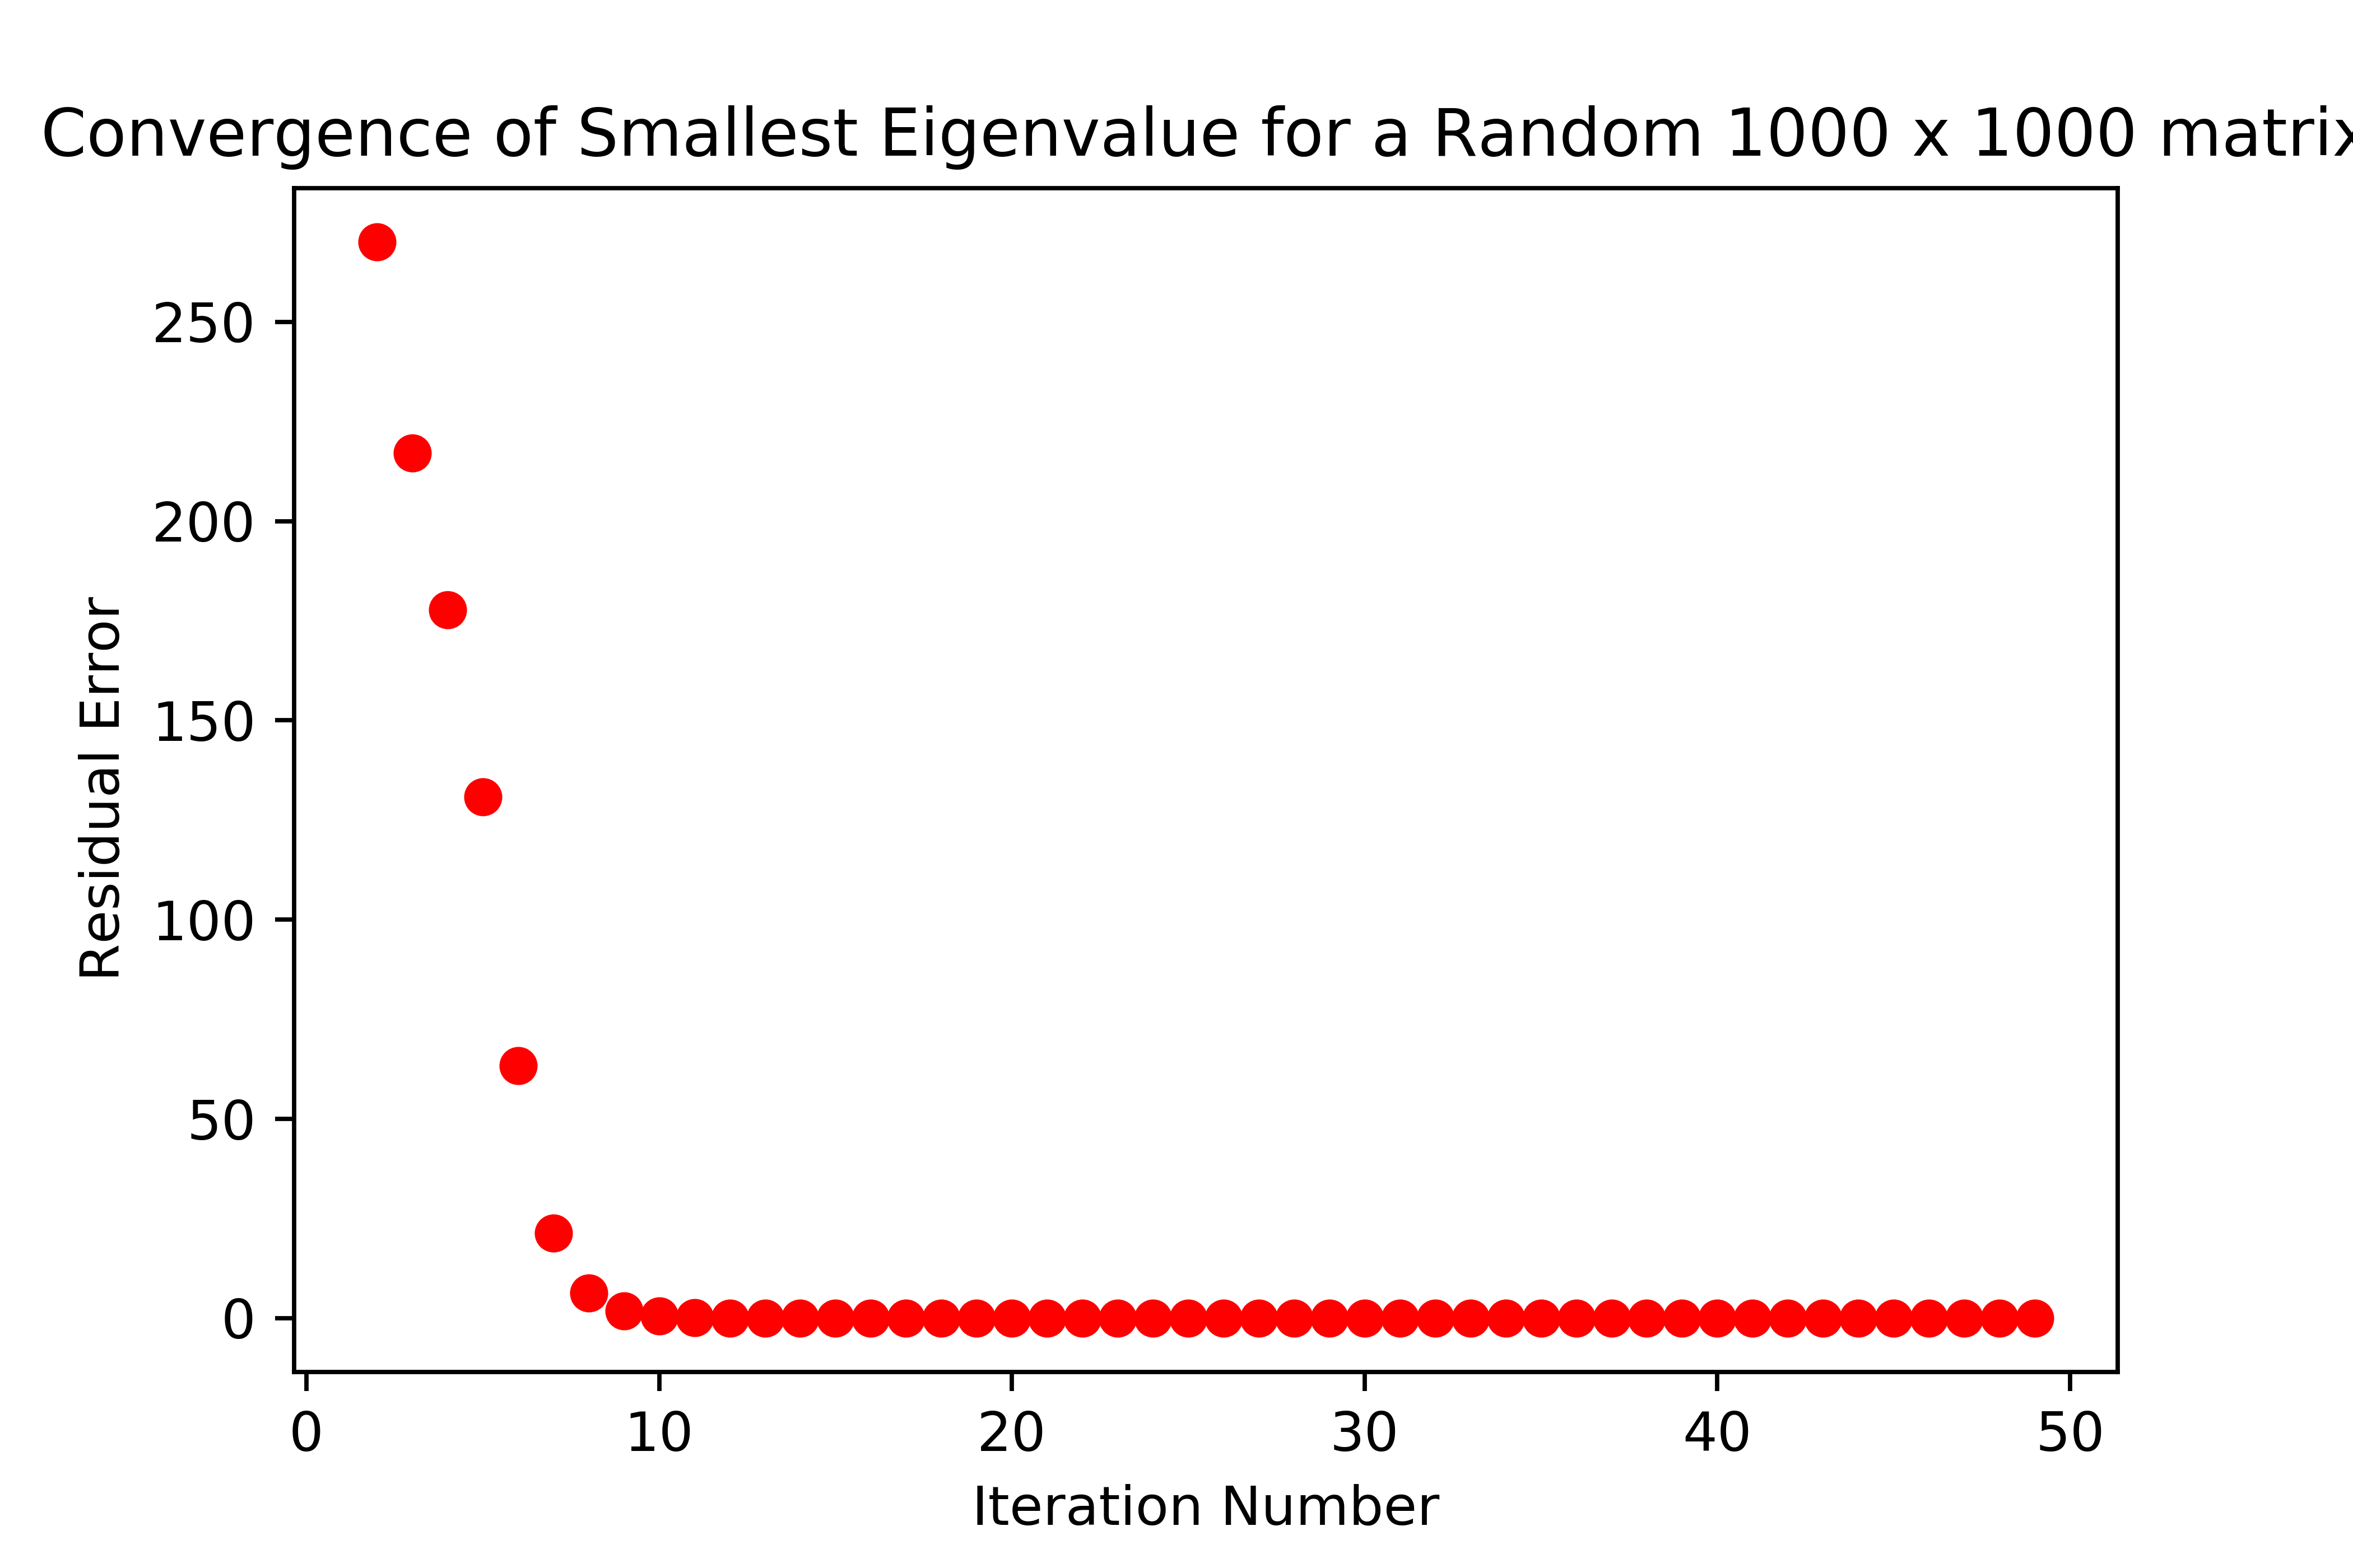
Comparing Lanczos’ vs Default Python 1000x1000 case
Time Comparison for finding all roots
**** NO STOPPING CRITERIA, RAN ~50 ITERATIONS ****

Slide 9
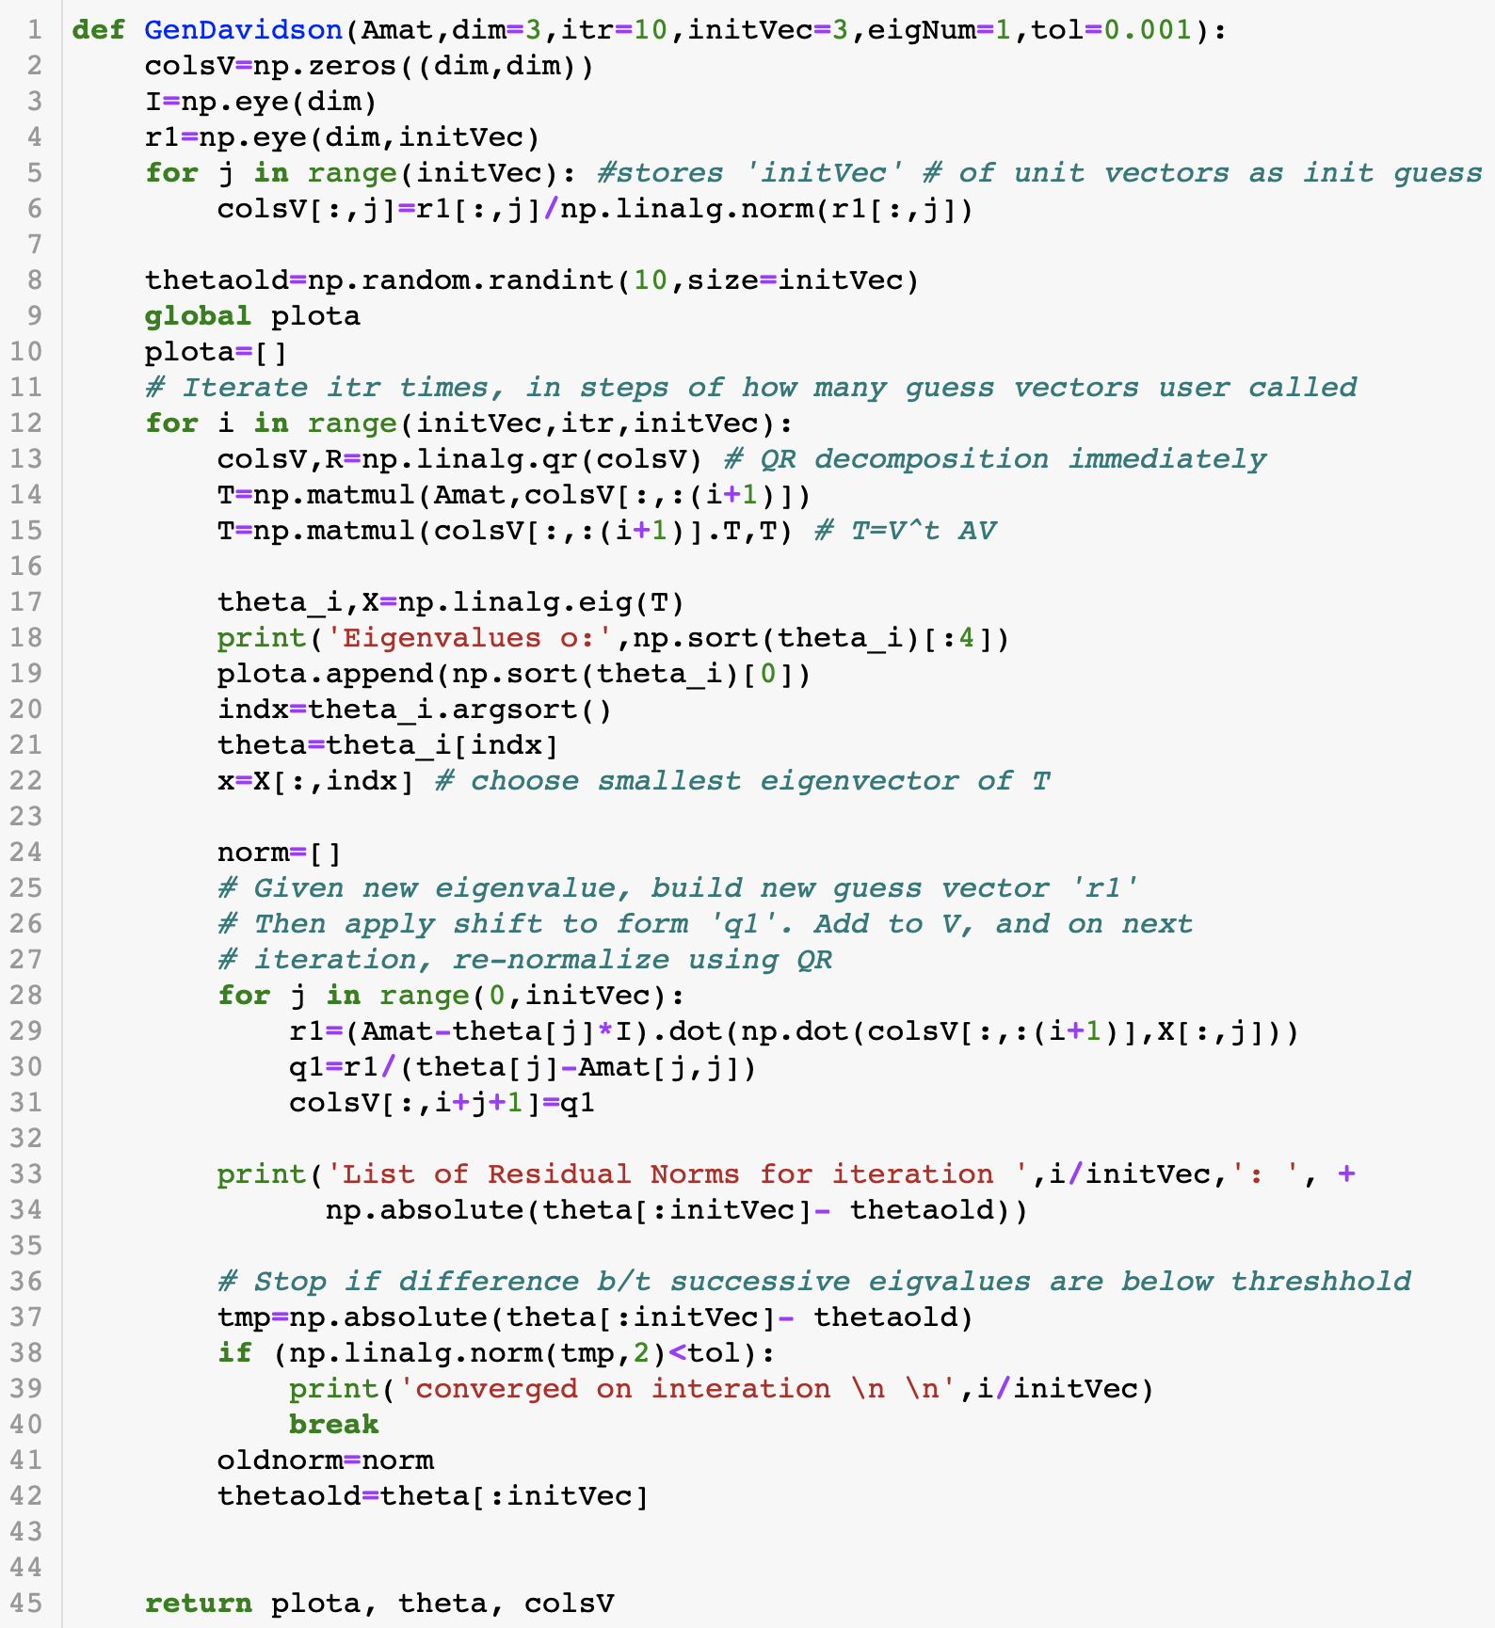
Davidson’s Diagonalization
Initialize a user determined number of guess unit vectors (initVec) and other info (maximum iterations)
Do i=initVec,maxIter,initVec
QR decomposition to orthonormalize guess vectors; VR=V’
Project A onto columns of V; T=V^t AV
Diagonalize T
Do j=1,initVec
Build new r1 guess, normalize
Insert into column i+j of V
Converged?

Slide 10
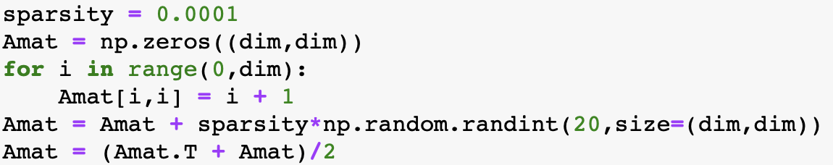
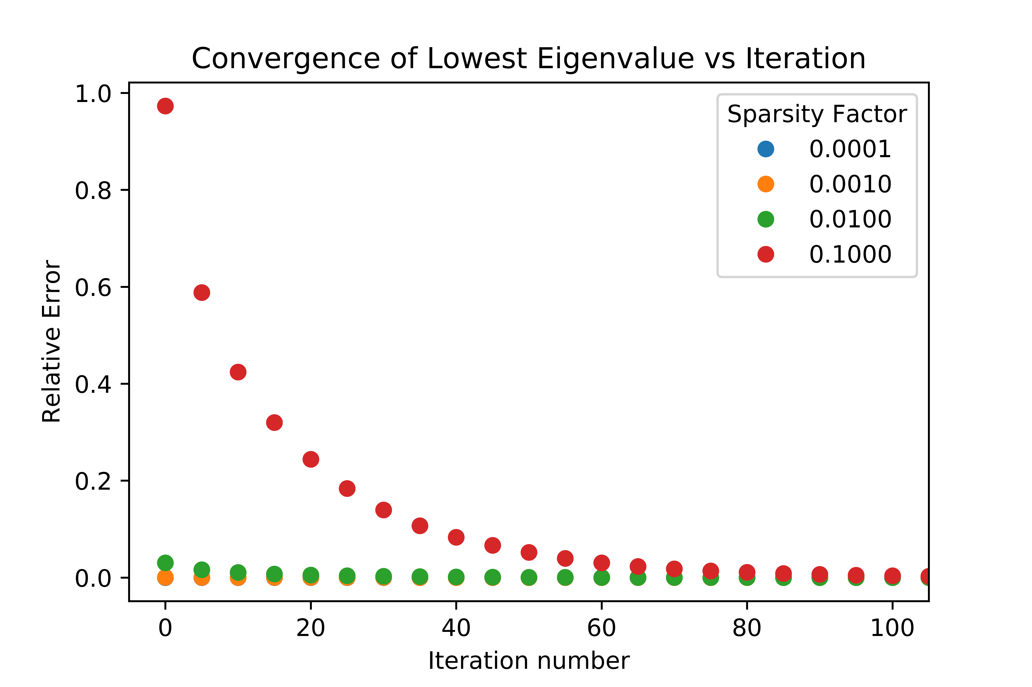
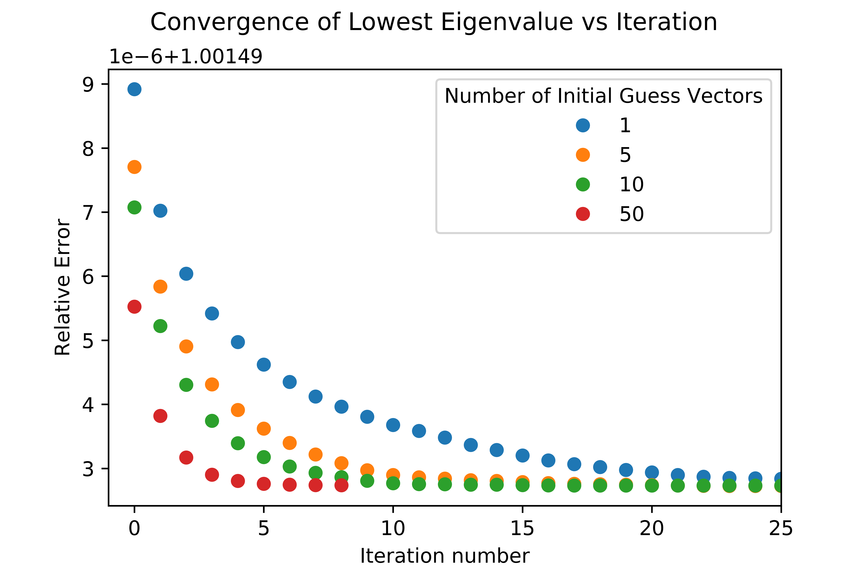
Davidson’s Implementation (Hermitian A)
**** NO STOPPING CRITERIA, RAN >50 ITERATIONS ****

Slide 11
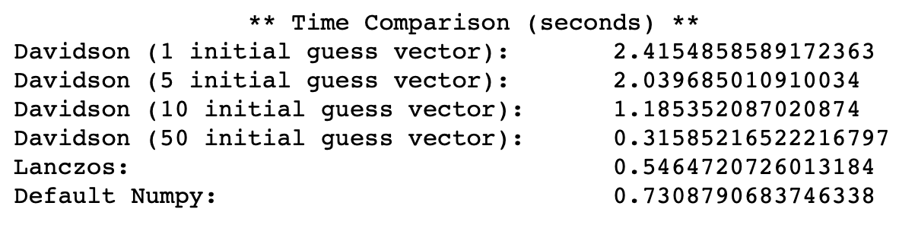

Diagonalization Comparison
**** WITH STOPPING CRITERIA ****
1000x1000 A
Sparsity=0.01

